Slide 1
LLM Presentation
Mar 20th 2024
student_id = REA02Y3M
name = Rendy Kurnia
drive_link = GDrive
github = rendy-k/learning-LLM
Gradio deployment: Gradio (until March 23rd 2024)

Slide 2
Outline
The objective of your model.
A comprehensive description of your model.
The specific metrics used to measure your model's effectiveness.
A brief overview of the dataset used, including its source, pre-processing steps, and any insights.
An explanation of the methodology used in developing the model.
A discussion on challenges faced, how they were handled, and your learnings from those.
Suggestions for potential future improvements to the model.
A functioning link to a demo of your model in action.

Slide 3
1. The objective of your model
To develop an LLM model that can serve as a chatbot
To deploy it on Gradio
Trained with two unrelated documents:
Transform your Habits
Financial Data Scientist

Slide 4
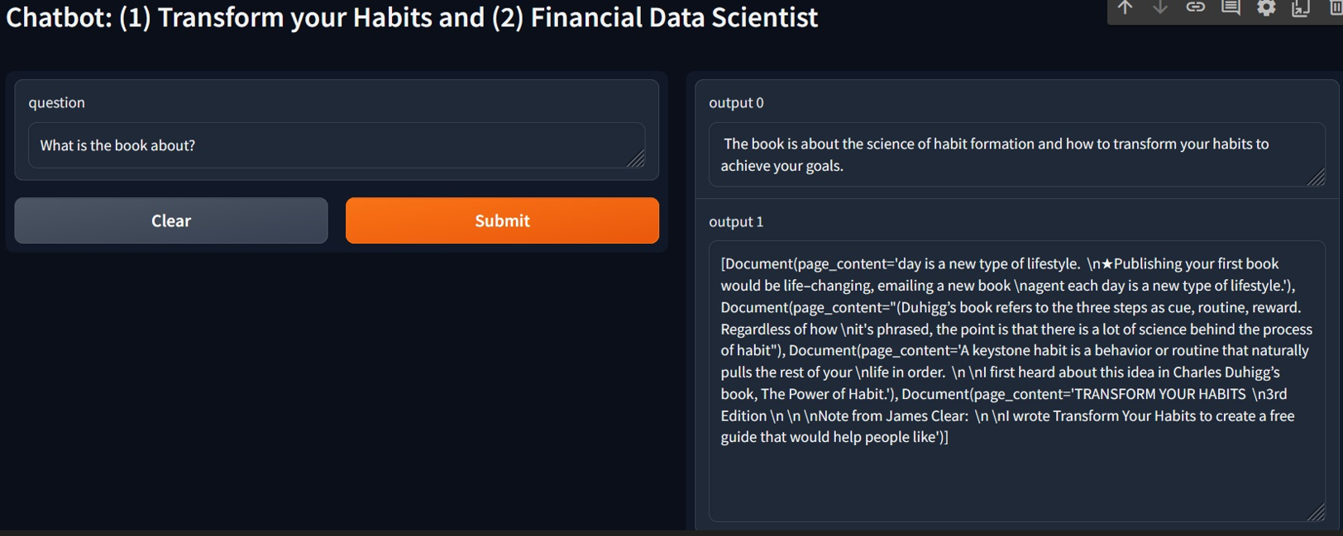
2. A comprehensive description of your model

Slide 5
2. A comprehensive description of your model (continued)
The LLM serves as a chatbot that interacts with users. Users can have a chat or question for the LLM chatbot model. The model can answer based on the trained documents.
The LLM chatbot is deployed on Gradio.
The application accepts 1 input and returns 2 outputs.
The 1 input is the question (or query) given by the users.
Then, by clicking the orange “submit” button, the application will return 2 outputs.
The first output is the answer to the given question.
The second output is the document source parts supporting the answer.

Slide 6
3. The specific metrics used to measure your model's effectiveness
There is no specific metric used to measure the model performance.
The model is tested with some questions and scored manually.
Question 1: how to build a strong habit?
LLM asnwer: To build a strong habit, you need to use a current habit as the reminder for your new one. This is because it’s much easier to build a new habit if you’re already doing something similar.
For example, if you’re trying to build a new habit of exercising, you can use a current habit like brushing your teeth as the reminder. This way, you’re more likely to stick to your new habit because it’s already part of your routine
Expected answer: (1) Reminder (the trigger that initiates the behavior), (2) Routine (the behavior itself; the action you take), (3) Reward (the benefit you gain from doing the behavior)
Comment: Only answers one out of three key answers
Score: 50

Slide 7
3. The specific metrics used to measure your model's effectiveness
Question 2: how to make myself feel happier?
LLM asnwer: 1. Express gratitude: Take time each day to reflect on what you're thankful for.
2. Take care of your body: Eat healthy, exercise regularly, and get enough sleep.
3. Practice self-care: Do things that make you happy, such as reading a book or spending time with loved ones.
4. Make time for hobbies: Engage in activities that bring you joy and fulfillment.
5. Practice mindfulness: Focus on the present
Expected answer: Expressing gratitude is one proven way to boost happiness
Comment: Correctly answered. Suspect that the 4th and 5th answer is not from the document.
Score: 100

Slide 8
3. The specific metrics used to measure your model's effectiveness
Question 3: What does keystone habit mean?
LLM asnwer: Keystone habits are a set of daily activities that can help you achieve your long-term goals. They are the small things you do that can have a big impact on your life. For example, if you want to be more productive, you can use a keystone habit like setting a timer to work for 25 minutes and then taking a 5-minute break. This can help you stay focused and get more done.
Expected answer: A keystone habit is a behavior or routine that naturally pulls the rest of your
life in order
Comment: Correctly answered
Score: 100

Slide 9
3. The specific metrics used to measure your model's effectiveness
Question 4: Is it true that proving small wins is a way to sustain success??
LLM asnwer: Yes, it is true. Proving small wins is a powerful way to sustain success. It helps you stay motivated and focused on your goals. By starting with small wins, you can build momentum and gradually increase the size of your successes. This can help you stay on track and maintain your progress over time.
Expected answer: yes
Comment: Correctly answered
Score: 100

Slide 10
3. The specific metrics used to measure your model's effectiveness
Question 5: I want to start a new habit with a big step. Can it work?
LLM asnwer: Yes, it can. Here's how.
1. Start small.
2. Make it easy.
3. Reward yourself.
4. Make it a habit.
5. Keep it up.
Here's an example:
1. Start small: Start with a small step that you can do easily.
2. Make it easy: Make it so that you can do it without much effort.
3. Reward yourself: Reward yourself for taking
Expected answer: No
Comment: Should answer no. Then, explain the corrext answer.
Score: 10

Slide 11
3. The specific metrics used to measure your model's effectiveness
Question 6: how to cook an egg?
LLM asnwer: To cook an egg, you need to bring water to a boil, then carefully lower the egg into the water. The egg will cook for about 5-7 minutes, depending on the size. Once the egg is cooked, you can remove it from the water and place it on a plate.
Expected answer: (No answer)
Comment: Expect the LLM to reply with not knowing the answer. It has its own knowledge.
Score: 0

Slide 12
3. The specific metrics used to measure your model's effectiveness
Question 7: What is a financial data scientist?
LLM asnwer: A financial data scientist is an expert in analyzing and interpreting complex financial data to help businesses make better decisions. They use a variety of data analysis tools and techniques to uncover insights and trends in financial data. They are also responsible for developing predictive models and algorithms to help businesses anticipate future trends and make more informed decisions.
Expected answer: Financial data scientists are industry experts with specialist, in-depth domain knowledge.
Comment: Seems like is has its own knowledge.
Score: 100

Slide 13
3. The specific metrics used to measure your model's effectiveness
Question 8: What is a financial data scientist?
LLM asnwer: A financial data scientist is an expert in analyzing and interpreting complex financial data to help businesses make better decisions. They use a variety of data analysis tools and techniques to uncover insights and trends in financial data. They are also responsible for developing predictive models and algorithms to help businesses anticipate future trends and make more informed decisions.
Expected answer: Financial data scientists are industry experts with specialist, in-depth domain knowledge.
Comment: Seems like is has its own knowledge.
Score: 40

Slide 14
4. A brief overview of the dataset
Datasets:
Transform your habits: James Clear
Financial Data Scientist, source: careerfoundary
Pre-processing:
Combining documents
Document splitting
Embeddings

Slide 15
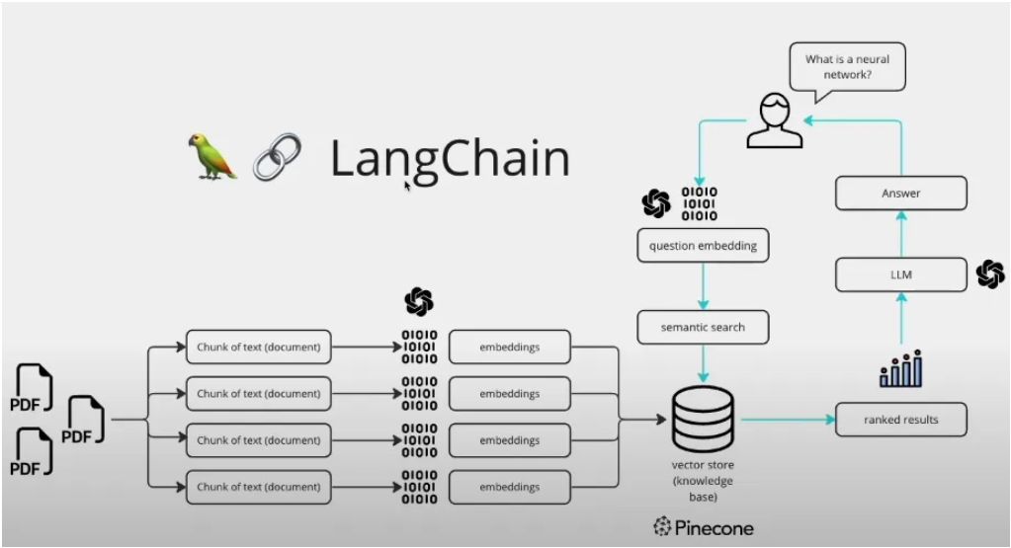
5. An explanation of the methodology
Source

Slide 16
5. An explanation of the methodology
Load files
Split documents into chunks
Apply embeddings and save the vector store or database
User gives a question
Question embedding
Semantic search to find similar chunks from the vector store
LLM to generate the text-based human languages based on the similar chunks
Text-based answer to return to the user

Slide 17
6. A discussion on challenges faced
There is no any difficult challenge found.

Slide 18
7. Suggestions for potential future improvements to the model
Develop a streamlit web application as the chat interface
Develop a streamlit app as the interface to upload documents for training (splitting and embeddings)

Slide 19
8. A functioning link to a demo of your model in action
Github = rendy-k/learning-LLM
(find the Readme file to demonstrate the deployment)
Gradio deployment: Gradio (may not be active)

